Slide 1

2020 College Basketball Prediction
Matthew Forey Nathan Keckley
Andrew Locker Ricardo Munoz

Slide 2
Background
Fans love to predict the outcomes of games.
Some games are harder to predict than others.
Predicting winners , total points scored, and likelihood of a low-ranked team defeating a higher-ranked team.
Notes:
Fans of college basketball have always loved to compete with each other and try to predict the outcomes of games, especially in the end of season tournament
Picking correct winners can be simple when a large school with better players faces smaller schools with much lesser basketball talent, but can be more challenging to predict as the season progresses and the tournament begins
As basketball fans ourselves, we enjoy watching games and predicting who will win, how many points will be scored, and quantifying the likelihood of a low-ranked team defeating a higher-ranked team

Slide 3
Motivation
With this year's tournament canceled, we were motivated to attempt to find a prediction model that will help us predict games accurately several different metrics:
Total score
Point differential
Classify a team as a winner or loser for a game
Goal is to choose a model that performs well using team statistics variables for two opposing teams to predict a game winner
As basketball fans we hope to be able to use these models for monetary gain for years to come.

Slide 4
Main Questions
Which team should win the game?
What predictors are most important for winning games?
Is there an edge to be found between what we project the game total/spread to be and what oddsmakers think?

Slide 5
Main Questions
Which team will win the game?
College games are harder to predict
Large variation in team performance
Logistic regression
Notes:
Player skill levels, shorter seasons, teams having say in their own scheduling
Using logistic regression, we plan to calculate the true odds of a team winning a game and see if there is an edge on either team.
Example: Las Vegas predicts that a team has a 60% chance to win a game, but we project that probability to be closer to 70%- there might be a monetary advantage.

Slide 6
Main Questions
What predictors (statistics) are most important for winning games?
Basketball is a changing sport
Offense or defense
Many variables
Notes:
Lots of roster turnover season-to season, less familiarity between opponents
Also because of the nature of ametuer atheltics, teams can schedule hand-picked opponents to optimize their season performance and bring in the most revenue to the school. Plus, much shorter season (30 ish games compared to 82 professional games)
Quality of play is pretty volatile with college athletes
So we want to find the basketball factors that are most important to the college basketball game
Basketball is a changing sport, especially in college. We hope to find out which factors lead to wins more often than others.
For context, we are looking at whether a team’s offense or defense is more important in determining who wins the game.
The group will analyze many variables and try to pinpoint which statistics are the most important.

Slide 7
Main Questions
Is there an edge to be found between what we project the game total to be and what oddsmakers think?
Discrepancy between our model and betting odds.
Combined score for both teams in a game
Game spreads
Linear regression
Notes:
The goal is to find a discrepancy between our model and betting odds.
A common bet: predict whether the combined score for both teams in a game will go over or stay under the number that bookmakers have stated.
Through linear regression, we are hopeful to find a large difference between our model and the total.

Slide 8
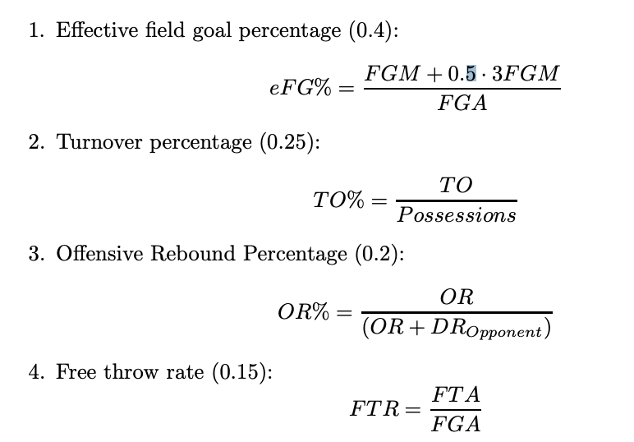
Literature Review
Predicting NCAA Basketball can prove to be more difficult than other sports due to its amateuristic nature
Dean Oliver and the Four Statistics:
Score efficiently, protect the basketball, grab many rebounds, and get to the free-throw line often
Notes:
As Andrew mentioned, predicting what will happen in college basketball games can prove to be more difficult than professional sports due to its amateuristic nature, large quantity of teams, and condensed schedules.
Before selecting the basketball statistics to look at in our prediction models, we looked at what others have concluded about the sport..
Dean Oliver (prominent basketball statistician) identified what he called the "Four Factors of Basketball Success", or the keys to successfully win at basketball: they are a team’s Effective field goal %, Turnover %, Off Reb %, and Free Throw Rate
(you can see here his methods for calculating these metrics)
What that means is that for a team to have the best chance of winning, they must be able to score efficiently, protect the basketball on offense, grab as many rebounds as possible, and get to the free throw line often.

Slide 9
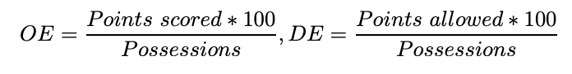
Literature Review
Ken Pomeroy: adjusting efficiencies to the opponent’s quality
Must normalize variables to be relative to rest of the league
High offensive statistics against a weak defensive opponent should be considered less impressive than a team that has similar statistics against better-defending opponents
Normalize teams’ points scored and points allowed per 100 possessions, deriving offensive and defensive efficiencies
By normalizing variables, the data is able to be seen on scale to the rest of the league.
Notes:
Ken Pomeroy, a noted college basketball statistician, introduced the idea of adjusting efficiencies to the opponent’s quality.
The importance of normalizing variables helps adjust the statistics of a team in relation to the level of its competition.
For example, a team that puts up impressive offensive statistics against an opponent that is pretty weak defensively should have their statistics penalized compared to a team that puts up similar statistics against much tougher defensive opponents
You can see here an example of a way to normalize a total of team’s points scored in a game by dividing by the number of possessions they had in that game to get their offensive efficiency, or in a similar fashion normalize the points-allowed to derive their defensive efficiency
We could similar transformations with Statistics like offensive rebound rate or turnover rate.

Slide 10
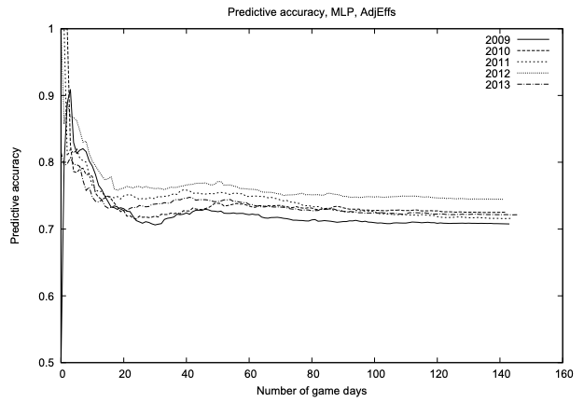
Literature Review
Analysts find: “glass ceiling”
Shi, Moorthy, and Zimmerman used various ML techniques:
Decision Trees
Rule Learners
Neural Networks
Naive Bayes
Ensemble Methods
As season progresses, their accuracy for game classification normalizes around 70% as expected
Our goal: use “Four Factors” with other normalized variables, to replicate the predictive power described in this study
Notes:
Finally , we found there is a consensus among college basketball analysts that there is a “glass ceiling” in predictive models.
Many researchers have found that when using various machine learning techniques, as the number of game observations they include in their models increases, their prediction accuracy will fall and level off at a certain point - about 70% accuracy rate - which they describe as the glass ceiling.
By using the “Four Factors” of Dean Oliver along with other normalized variables we create, we will attempt to replicate the predictive power described in this study to build similar models

Slide 11
Data
10,518 observations and 62 predictors
All college basketball games between two Division-I basketball teams for the 2019-2020 season
Teams stats change with each given year, so we plan on using the first few months of data as our training set and then use the final two months as our test set
Notes:
The initial dataset consists of over 10 thousand observations and 62 chosen predictors that describe the data. This data consists of all the college basketball games between two Division-I basketball teams from the 2019-2020 season. Since in college basketball the teams stats change with each given year, we plan on using the first few months of data as our training set and then use the final two months of the season as our test set, as opposed to pulling in stats from prior years teams.

Slide 12
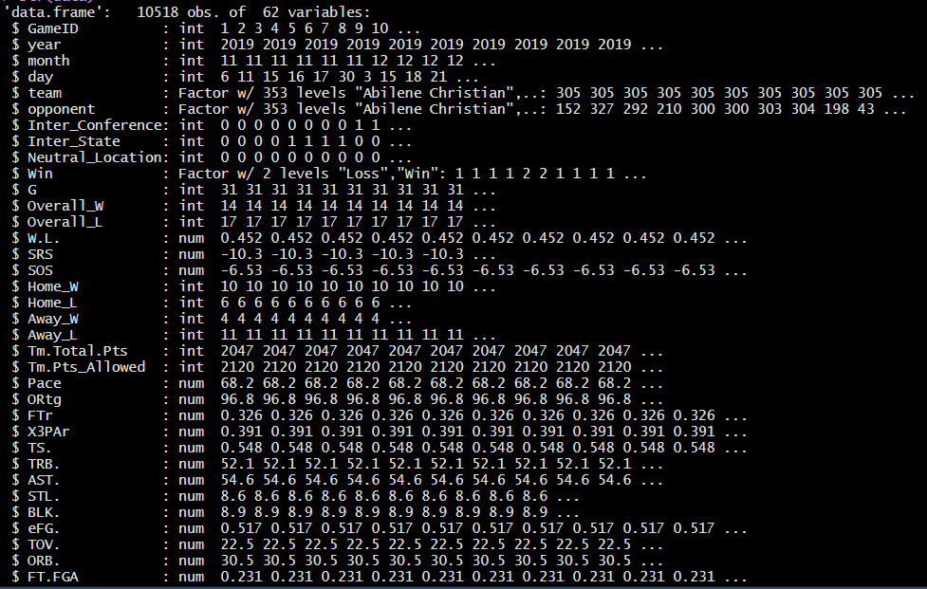
Notes:
In searching for variables to use as predictors, we were able to find many statistics that easily measured offensive performance such as field goals made, three-point shots made, and stats like offensive rebounds which can provide an additional attempt at scoring on a possession,
and also turnovers that can deprive a team of an opportunity to score on a possession.
Defensively speaking, we used stats like defensive rebounds that end the opponent’s possession and give a team control of the ball, and also steals that have the same effect and can make up part of the opponent’s turnovers, as well as blocks, which prevent the opponent from scoring.
In addition, we included data about whether the team in a matchup was playing a conference rival, a state rival, or at a neutral location. We believed these predictors play crucial roles in the performance of a basketball game.

Slide 13
Analysis Techniques
Exploratory
Restructure and visualize the dataset
Inferential
Linear and logistic regression
Tree-based models
Discriminatory analysis
Notes:
Analysis techniques
We conducted our analysis using a two-fold approach: first exploratory techniques to restructure and visualize the relationship between predictors.
Additionally the inferential analysis will consist of linear and logistic regression, tree-based models, and discriminatory analysis.

Slide 14
Data Exploration
Preprocessing
Created variables
Win/Loss binary column
Combined score
Margin
Observations about the data
Visuals of data structure and distribution
Notes:
Data exploration is the first step in our analysis. We did some preprocessing to check the distribution of our dataset, and created additional variables.
The first step was to insert a column that dictates whether a team won or not. For example, the home team would represent the ‘positive class’ and if they won the game, the observation in that column would have a 1. This served as the dependant variable for the models where we wanted to pick a head-to-head winner for a game
Additionally, we created a dependent variable that is simply the combined score of the game (or the total points scored).
Lastly, the spread dependent variable was created from taking the winning margin for the home team.
We included graphs to try and get a better understanding of the relationships between different stats. The only variables used were the ones deemed to be significant

Slide 15
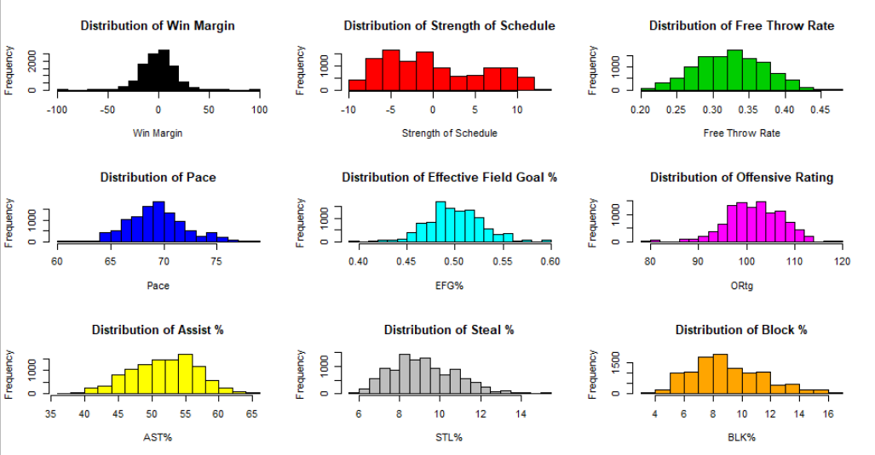
Distribution
Notes:
As seen in our distributions, our data is for the most part, normally distributed. There are a few statistics with major outliers, such as the Distribution of Win Margin (black), Pace (blue), and Effective Field Goal % (turquoise), but in general we are seeing normal distributions inside of the first quartiles, and very little Skewness for the most part.
However, Strength of Schedule (red) did appear skewed, so we ended up using the margin of strength of schedule between the two teams, which alleviated the skewness issue.

Slide 16
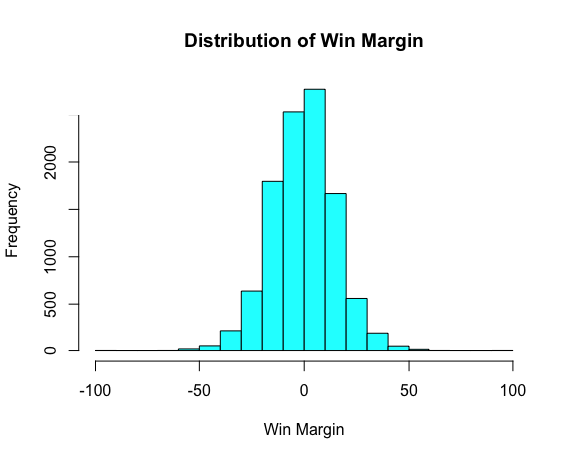
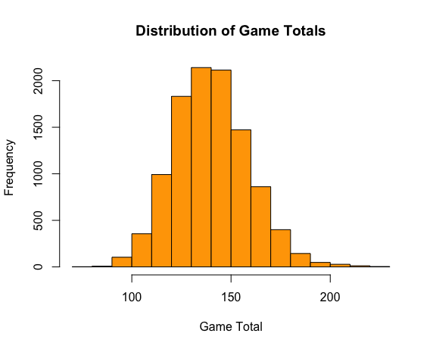
Response Variable
Skewness : 0.31
Skewness : -0.04
Notes:
2 of our response variables used in our different models, Win Margin and Game Totals, are visualized here with their skewness levels.
Win margin was only used when we wanted to predict spreads, (which can be described as the predicted difference between one teams score and the other), and then we could compare with predicted spreads for sports books in Vegas.
Additionally, Game totals was only used when we wanted to predict the combined score of the two 2 teams in a given matchup, and measure those with the oddsmakers as well.

Slide 17
Inferential Analysis
Point Spread
Linear
Ridge
Elastic net
Decision Tree
PLS
PCR
Random Forest
SVM
Game Total
Linear
Ridge
Elastic net
Decision Tree
PLS
PCR
Random Forest
SVM
Who wins the game
Logistic Model
SVM
Random Forest
Notes:
Our further analysis will consist of 3 main parts:
A comparison of spread models, where the Point-spread predictor is “Win Margin”
A comparison of total-points-scored models, where the Game-total predictor is the variable “Game Totals”
And a comparison of head-to-head game winner predictions models, where the game predictor is a “Win/Loss” binary column

Slide 18
Game Spreads
Notes:
Various classification models

Slide 19
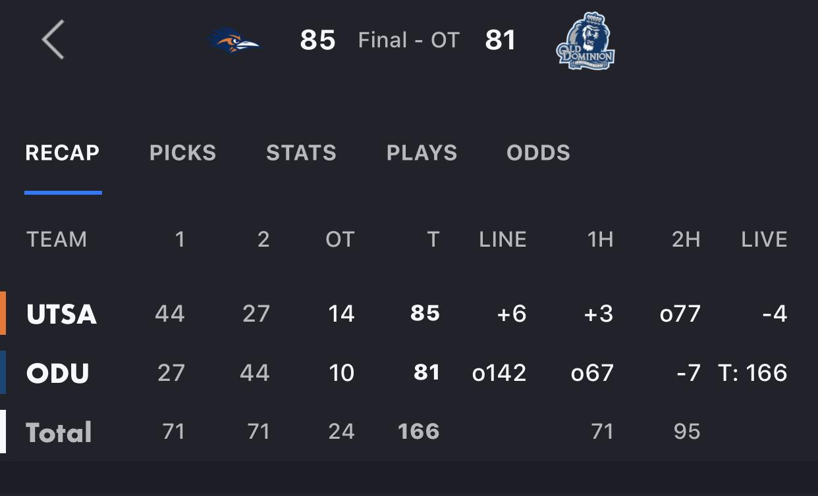
Game Spread
How does the bet work?
Is there an opportunity for a profit?
Example
Game | Vegas Prediction | Our Prediction | Game Total
UTSA vs Old Dominion | UTSA Loses by 6 | UTSA by 1 | UTSA wins by 4
Notes:
The game shown to the right is an example of a game between UTSA and Old Dominion.
99% of games during the college season can be bet on
Bet 110 to win 100, vegas wants to get the same amount of money bet on both sides
Our challenge is to predict which games to bet and is there a opportunity for profit?
UTSA is projected to lose the game by 6 according to vegas bookmakers
We predict the game to be a toss up
In this instance we would be UTSA +6 points and win the bet
We can't necessarily bet every game, we’ll get into that a bit later

Slide 20
Model Accuracy
Model | Model MSE
Linear | 127.24
Ridge | 127.26
Elastic-Net | 127.28
Decision Tree | 151.36
PLS | 127.26
PCR | 127.29
Random Forest | 140.29
SVM | 127.93
Notes:
Used 8 different models
We see that the linear model is our best model by a bit
Ridge and Elastic net are slightly behind, due to a very low lambda which is our penalizing parameter
We can see that ensemble methods performed pretty poorly in this example
Random Forest was tuned to give optimal projections, but still fell short

Slide 21
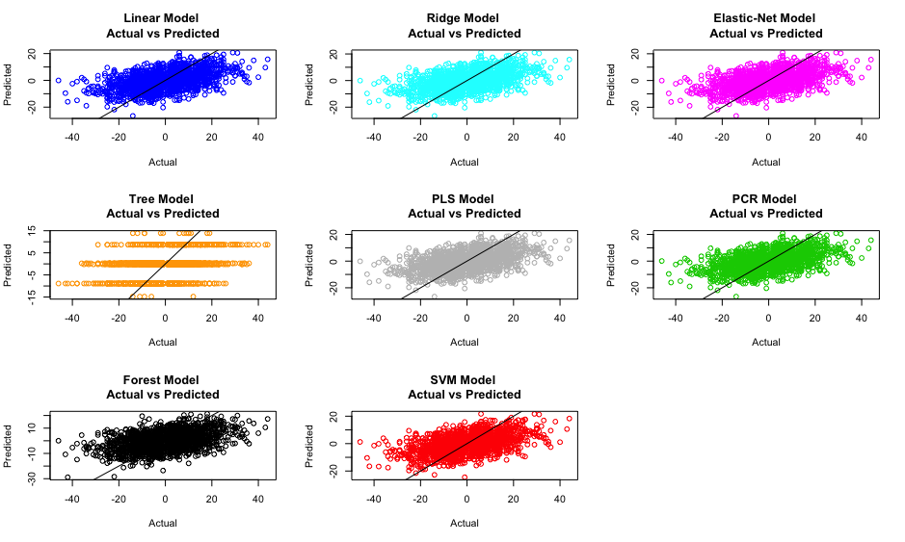
Model vs Win Margin
Notes:
Simply talk about how most of the models yielded similar results except for ensemble emthods

Slide 22
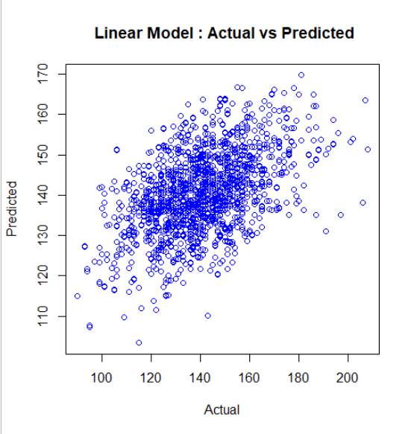
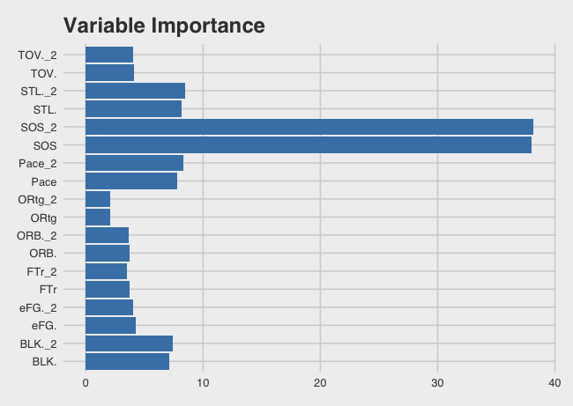
Best Model
R2: .4286
MSE: 127.24
Notes:
R2 of .4286 is encouraging due to the randomness of the games
Variable importance
Strength of schedule is the most important predictor by a wide margin
We see that how fast a team plays has a significant importance in predicting
BLKs and and STLs are also very important as they limit the amount of possessions in a game

Slide 23
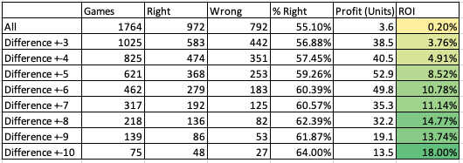
Worth the bet?
Notes:
We were able to get the actual vegas predictions for 1764 games and compare against our linear model
We won't necessarily bet every game due to the fact that it would be very expensive and volatile (barely making a profit)
Difference greater than 6 gets us to a 60% prediction
As the difference in our projection and vegas predictions increase, out ROI and accuracy goes up
Feel confident about the sample size

Slide 24
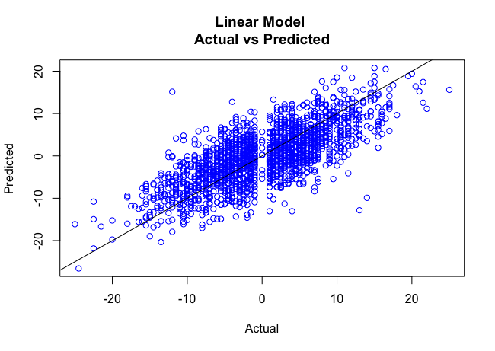
Game Spread Conclusions
There appears to be an edge on many occasions
High ROI for games with big difference
Sample Size is Encouraging
Effect of inter-conference games
Adjustments to player injuries
Reason to be encouraged
Notes:
Conclusions
As previously mentioned there is a edge to be had when our projection vastly differs from bookmakers
Lines move throughout the day
What may be a good bet in the morning is no longer a good bet in the afternoon
Adjustments
Effect of inter-conference or inter-state games (rivalries)
Adjustment to player injuries may improve our models

Slide 25
Game Totals

Slide 26
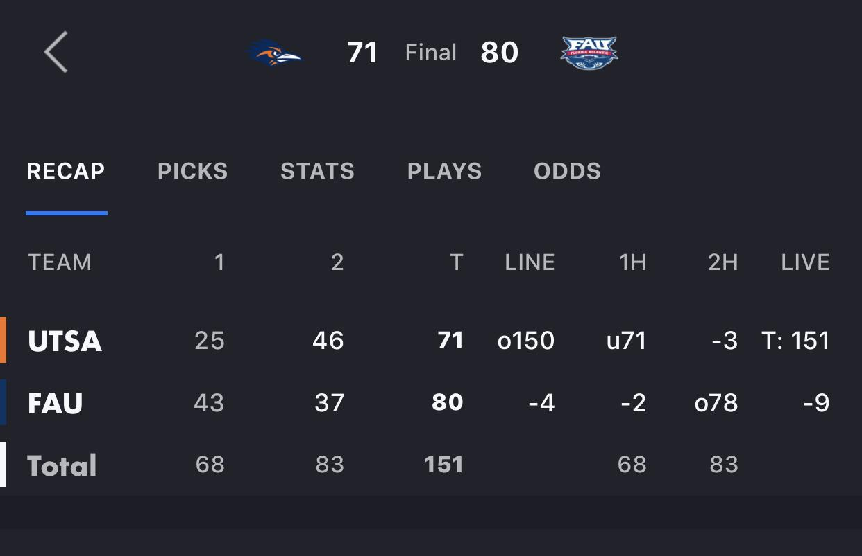
Game Total
How does the bet work?
Is there an opportunity for a profit?
Example
Game | Vegas Prediction | Our Prediction | Game Total
UTSA vs Florida Atlantic | 150 | 153 | 151
Notes:
The game shown to the right is an example of a game between UTSA and Florida Atlantic.
Similar to spreads we want to figure out is there an opportunity for a profit
The total for this game is projected to be 150, we predict it to be 153
In this instance we would bet that the total of the game goes over 150 and would win the bet

Slide 27
Model Accuracy
Model | Model MSE
Linear | 252.52
Ridge | 252.94
Elastic-Net | 252.86
Decision Tree | 284.60
PLS | 252.97
PCR | 252.94
Random Forest | 274.72
SVM | 252.57
Notes:
Again our linear model was out barely our best model
Our SVM model was slightly behind but due to interpretability we will continue with linear model
Again our ensemble methods struggled with predictions

Slide 28
Model vs Game Total
Notes:
Comparison of models
Little difference between linear, ridge, and elastic net (low lambda)

Slide 29
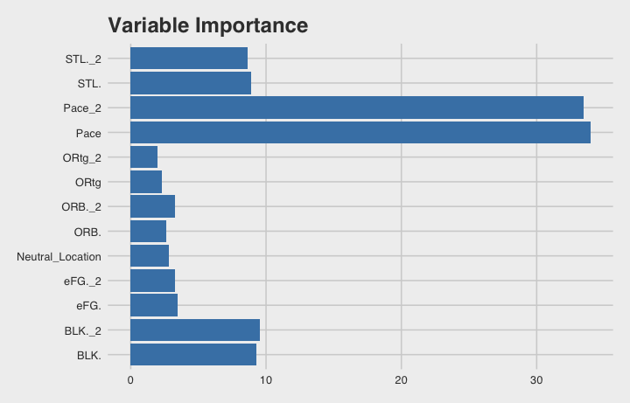
Best Model
R2: .2728
MSE: 252.52
Notes:
R2 less than optimal

Slide 30
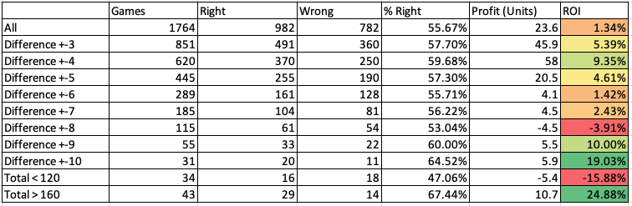
Worth the bet?
Notes:
Not as encouraging as spreads but still the opportunity for a profit
Difference greater than 9 gives is an ROI of greater than 10
Sample size is concerning
Games where we predicted the total to be > 160 our model performed especially well

Slide 31
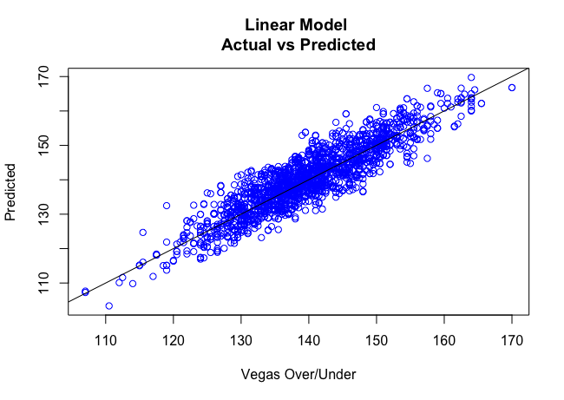
Game Total Conclusions
There appears to be an edge on games with high totals
High ROI for games with big difference
Need to study sample size
Still some work to be done
Add defensive variables
Explore the games that go into overtime
Reason to be encouraged
Notes:
Not as great as spreads but reason to be encouraged

Slide 32
Game Predictions
Notes:
Various classification models:

Slide 33
Model Comparison
Model | Accuracy | Sensitivity | Specificity
Logistic | .6678 | .6659 | .6697
SVM | .6672 | .6808 | .6539
Random Forest | .5907 | .5789 | .6022

Slide 34
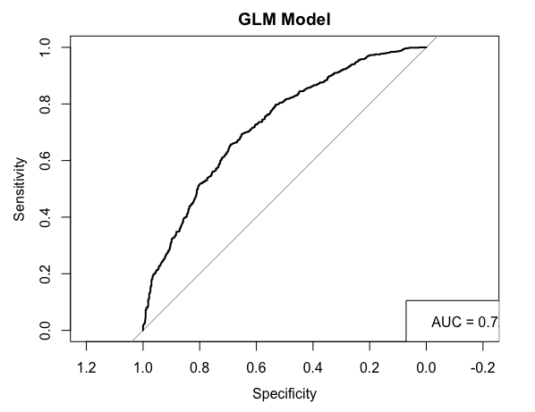
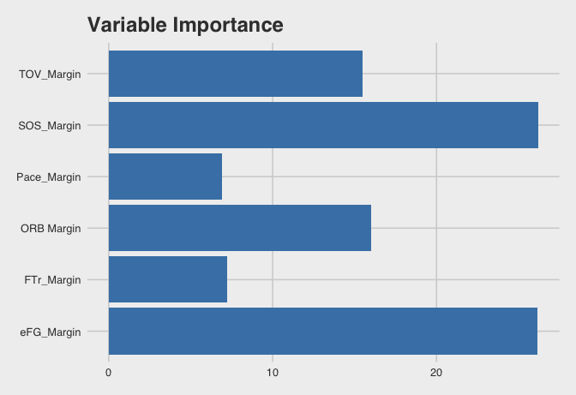
Prediction of who will win a game
GLM:

Slide 35
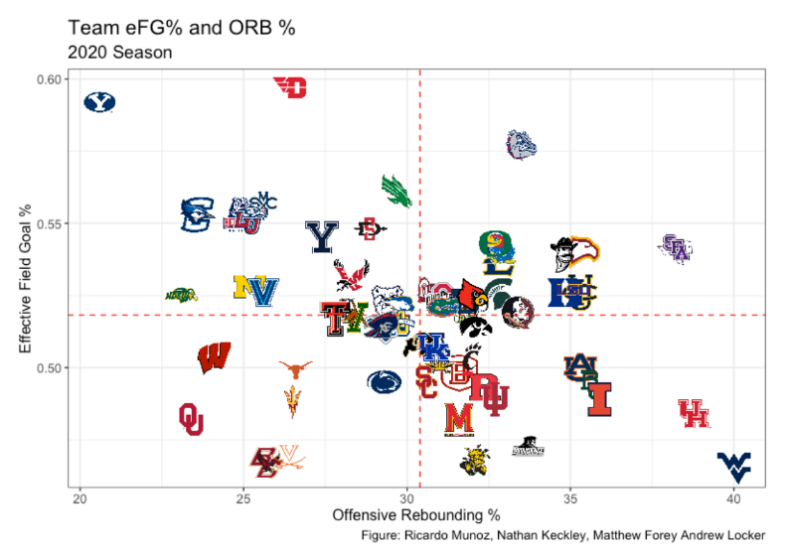
Effective Field Goal % and Offensive Rebounding %
Some good offensive teams may be such effective shooters, there are fewer missed shots to rebound (& vice versa)
Notes:
We can see that some of the consistently better teams this year reside in the 2nd quadrant, top right, such as kansas and gonzaga, and another top team Dayton, has the literal highest EFG rate out of the top 64 teams, but they may lack in offensive rebounding, more, but make up for it with their high efficiency. When weighting our variables a higher weight should be on eFG.

Slide 36
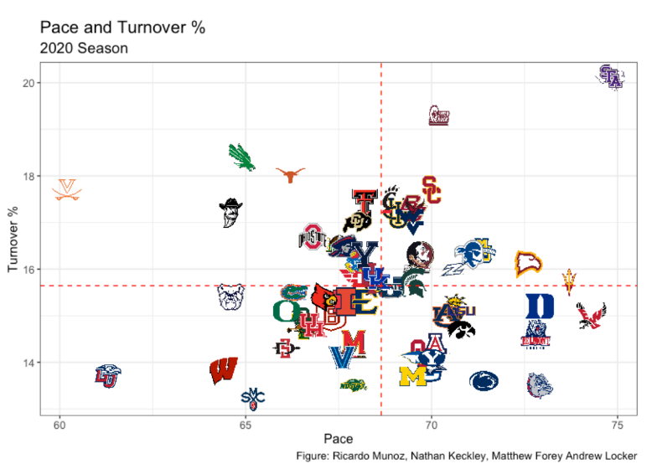
Pace and Turnover %
The quicker a team plays, they are more likely to turn the ball over and limit their total possessions.
Notes:
Another visual we wanted to explore dealt with how pace could affect turnover percentage. Our
train of thought was that if a team plays quicker than they are more likely to turn the ball over
and thus limit their number of possessions. Our hypothesis fails because it appears there is
no true relationship between the two variables. Other than Stephen F. Austin, which appears to
be an outlier, turns the ball over much more due to their pace. You will also notice teams such as last years winner, University of Virginia, plays very slow, a very old style of play they are known for, but are often successful. This is a variable we would like to be able to account for in the future better, as our model did not weight defensive variables as high.

Slide 37
Game Prediction Conclusions
Prediction accuracy is encouraging
Use this for March Madness
Add other variables
Normalized defensive oriented variables
Hot streaks

Slide 38
Recommendations
Questions:
Which team should win the game?
67% accuracy with GLM
What predictors are most important for winning games?
SOS and Eff. FG % were our most important variables, followed by Turnover % and Offensive Rebounding %
Dean Oliver’s “Four Factors” for winning a game: Eff. FG %, Turnover %, Offensive Rebounding %, Free Throw Rate
Is there an edge to be found between what we project the game total or spreads to be and what oddsmakers think?
Games with a high expected total (>160) have the highest ROI
Games with a projected difference > 9 have sufficient accuracy (60%)
Games with a spread > 6 have highest ROI and sufficient accuracy (60.39%)

Slide 39
Recommendations
Model deficiencies, improvements
Additional variables to use (Defensive Rating measurement)
Models tended to favor offensive statistics in predictions
Next steps
Expand dataset

Slide 40
Citations
Zimmermann, A., Moorthy, S., & Shi, Z. (1970, January 1). [PDF] Predicting NCAAB Match Outcomes Using ML Techniques - Some Results and Lessons Learned: Semantic Scholar. Retrieved from https://arxiv.org/pdf/1310.3607.pdf

